Slide 1


Data Governance @ SneakerPark
Prepared by: Elie Kawerk
Submitted on: 24 August 2021

Slide 2
Background
SneakerPark is an online shoe reseller that allows people to buy and sell used and new shoes. Buyers can bid for shoes or buy them outright, and sellers can set a price or sell to the highest bidder.
Each buyer and seller must have an active account in order to sell, bid, or purchase sneakers using SneakerPark’s website.
SneakerPark authenticates the shoes before shipping them to the buyer, so before listing an item, the seller must ship it to SneakerPark’s warehouse. Upon receipt, SneakerPark assigns an item number to each pair of sneakers and notifies the seller that they are now free to list their item. If the item is not listed within 45 days, SneakerPark returns it to the seller and sends an invoice to the seller for the shipping cost.
If the item is found to be inauthentic or in an unacceptable condition, it is also returned back to the seller in a similar fashion.
When the item sells, the buyer’s account is credited with the purchase price minus the SneakerPark service fee and shipping fees to deliver the item to the buyer.
Currently, SneakerPark only supports sales within the United States.

Slide 3
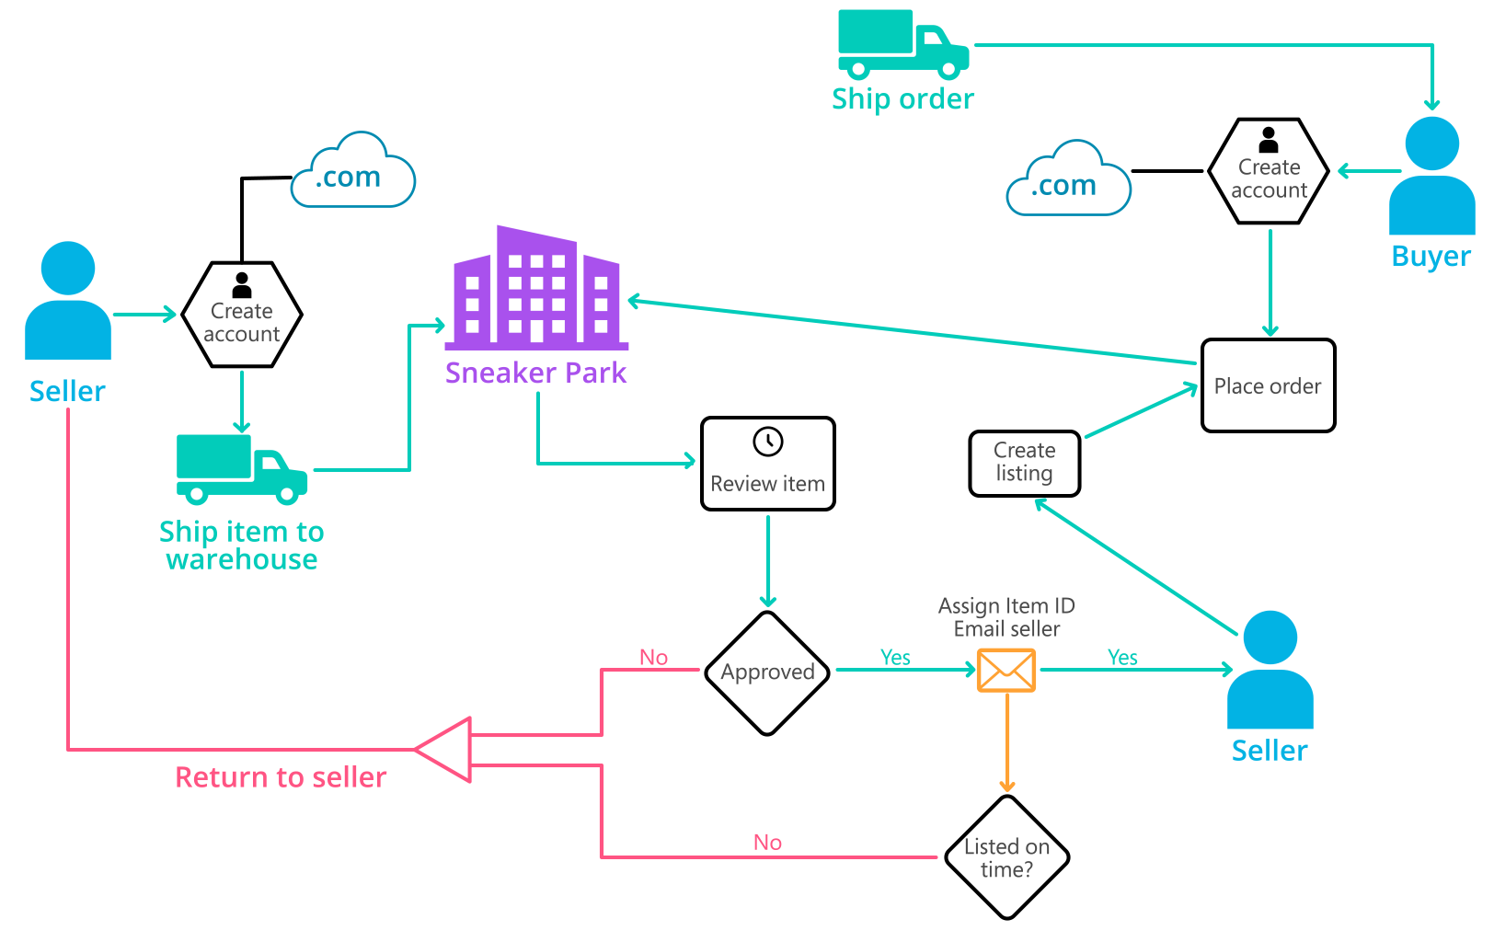
Background (cont’d)
Below you can see a diagram that will hopefully help you visualize some of SneakerPark's business processes. Keep in mind that it does not capture ALL processes and every nuance, but simply serves as another artifact to use in your project.

Slide 4
Step 1
Enterprise Data Catalog Part 1: Enterprise Data Model

Slide 5
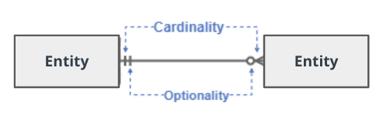
Create a conceptual data model that will provide SneakerPark with a holistic view of its data systems and help you grasp the organization's important entities and relationships, which will be instrumental as you move further in the project. You can use Lucidchart or any other diagramming tool of your choice, but please use the Crow’s Foot/IE Notation and please be sure to indicate both cardinality (the type of a relationship such as 1:N or N:N) and optionality (whether the relationship is optional or mandatory).

Slide 6
Replace the example below with your own solutions (obviously feel free to take more space):

Slide 7
Step 2
Enterprise Data Catalog Part 2: Metadata

Slide 8
Create the first version of the Metadata Catalog by documenting the metadata from all systems in the "Data Dictionary" and the “Enterprise Data Catalog” tabs of the provided Sheets template.
Please note that you are required to fill out all fields in both tabs.

Slide 9
Step 3
Data Quality
Part 1: Profiling and Cleansing

Slide 10
Profile the data to identify at least 3 data quality issues you see in the data. Also provide at least 1 data quality issue that you haven’t yet seen in the data, but can foresee occurring in the future. Based on the issues you’ve identified, come up with the data quality rule for each data quality issue, including for the one that you foresee.
Make sure you fill out all columns in the "Data Quality Issues" tab with your answers in the provided Sheets template.

Slide 11
Step 4
Data Quality
Part 2: Monitoring

Slide 12
Using the metrics you've created in the last step, please create a mock-up of a data quality monitoring dashboard that will be used to monitor the data to ensure compliance with your data quality rules.
Please make sure to label your metrics clearly on your mock-up.
Replace the example dashboard below with your own. (obviously feel free to take more space).

Slide 13
Consistency
Percentage of customers with consistent
lastname
Percentage of customers with consistent
firstname
0% 100%
0% 100%
Percentage of customers with consistent
email
Percentage of listings with products that have a consistent Shoe type
0% 100%
0% 100%
Completeness
Percentage of records with complete brand names
Percentage of customer service requests with a trackable order id
0% 100%
0% 100%
Accuracy
Percentage of records with accurate brand names
0% 100%

Slide 14
Step 5
Master Data Management
Part 1: MDM Architecture

Slide 15
Based on what you’ve read about SneakerPark’s systems and business model, sketch out a proposed MDM implementation architecture, and write a detailed explanation of why you chose this specific approach.
Tip: Think about how your plan and its implementation might affect existing systems.
Replace example screenshot below with your own solutions (obviously feel free to take more space).
Next, please write at least a paragraph explaining your choice.

Slide 16
Explanation:
Inventory
Management
System
User Service
MDM Hub
Listing
Service
Data
Warehouse
Order Processing Service
Customer Service Application

Slide 17
Explanation:
The diagram in the previous slide shows the suggested Master Data Management architecture that we recommend for Sneakerpark.
This architecture corresponds to a consolidated (or analytical) MDM where data is pulled from the following systems:
User service
Listing service
Order processing service
Inventory management
Customer application service
Into the MDM Hub where these data are consolidated (through validation rules) and where match and merge proceses are applied in order to generate golden records.
The reasoning behind this choice is the following: since Sneakerpark’s objective is to have high quality data flowing through a new data warehouse for accurate reporting and since it requires minimal disruption to its most critical systems (User Service, Order Processing Service, and Customer Service Application), any suggested MDM solution should not be invasive. Implementing a transactional MDM or a coexistence MDM would affect the source systems therefore violating the business constraints. On the other hand, implementing a registry MDM would be tedious to maintain and is meant more for ad-hoc analyses. The only solution that allows having high quality data flowing through a data warehouse with no disruption of source systems would be a consolidated MDM. With this solution, data consolidation happens in the MDM hub.

Slide 18
Step 6
Master Data Management
Part 2: Master Record

Slide 19
In this step, you will define a set of matching rules that will be used by the SneakerPark's MDM Hub to match item and customer entities between the company's different systems.
Please come up with 4 rules - 2 for Items and 2 for Customers and list them below.
For Items
The sources that contain item attributes/fields are: im.items and li.listings, pull the following item attributes: name, brand name, color, size, sex, condition, item status, price
Primary matching rule: match based on product id (li.listings.productid = im.items.itemid)
Secondary matching rule: None – flag as anomalous record
Standardization: standardize brand names, color, size, gender, and condition to match the same formats as in im.items.
Items matching Rules:
Brandname: compare im.items.brandname to li.listings.brand if the value is the same take the record to the MDM hub else flag the value for the data steward
Color: compare im.items.color to li.listings.color if the value is the same take the record to the MDM hub else flag the value for the data steward
Price: Take the value from li.listings.listingprice if it exists and push the record into the MDM hub else flag the value for the data steward
Name: Take the value from im.items.name if it exists and push the record into the MDM hub else flag the value for the data steward

Slide 20
For users:
The sources that contain item attributes/fields are: usr.users, usr.creditcards, and cs.customerservicerequests. The considered attributes are: userid, firstname, lastname, email, address, zipcode, creditcardnumber, creditcardexpirationdate, phone
Standardization: standardize phone number in cs.customerservicerequests to the format 999-999-9999
Primary matching rule: match based on userid (usr.users.userid = usr.creditcards.userid = cd. Customerservicerequests.userid)
Secondary matching rule:
Match based on firstname, lastname, and email or phone between users and customerservicerequests
users matching Rules:
Firstname: Compare usr.users.firstname to cs.customerservicerequests.firstname if they agree take usr.users.firstname if available and push to MDM hub else report to data steward
lastname: Compare usr.users.lastname to cs.customerservicerequests. lastname if they agree take usr.users. lastname if available and push to MDM hub else report to data steward
Email: Compare usr.users.email to cs.customerservicerequests.email if they agree take usr.users.email if available and push to MDM hub else report to data steward

Slide 21
Step 7
Data Governance:
Roles and Responsibilities

Slide 22
Write 1-2 paragraphs discussing what data governance roles and responsibilities will be necessary to oversee this new Data Management initiative. Please be sure to discuss the responsibilities in the context of at least 3 different aspects of Data Governance (such as Data Quality Management, Metadata Management, MDM, etc). Based on what you know, do SneakerPark's current employees have the necessary skills for these roles or should the company make new hires?

Slide 23
Current Environment
Based on the project overview section, in the current setting Sneakerpark’s personnel is inconveniently handling the data issues.
Jake – the IT support guy – does not have the skills nor the experience in managing the technical aspects of an enterprise data management program. Jake plays the role of IT support with rudimentary database administration responsibilities.
On the other hand, Jessica – the senior business analyst – has been able to support efficiently in identifying and fixing data issues. However, such tasks appear to be time consuming and sometimes overwhelming in addition to her other responsibilities.
Recommended New Roles & Their responsibilities
Sneakerpark needs two additional roles (new hires) in order to efficiently build a modern Enterprise data management program:
Data Engineer: a data professional responsible of the technical aspects of the program. To handle data quality, they would build automated pipelines that implement validation rules, automated detection of data quality issues. They would build the technical platform for an MDM Hub by implementing a consolidation system that standardizes, matches and merges the data automatically and alerts in case of a failure. For Metadata Management, they would contribute to building a Metadata Management technical solution (continued next side)

Slide 24
That consists of a metadata repository with connectors to the metadata sources and a processing engine to continuously ingest and process the metadata.
A data steward: a data professional responsible of curating the data and contributing continuously to refining data quality. In terms of data quality they would be responsible in picking up anomalous records that are automatically identified and uncover issues or enquire about issues with subject matter experts in order to refine existing data validation rules. In terms of MDM, they would define/update match rules, approve or reject matches, review rejected records, and even create new golden records. For Metadata Management, they would be owning the creation and update of business, technical, and operational metadata.

Slide 25
Standout Suggestions

Slide 26
Create a Business Glossary for SneakerPark and define common terms such as Item, Buyer, etc. Think and discuss how SneakerPark can improve on the consistency of the terms that its systems currently use. (You can use the “Business Glossary” tab of the same Sheets template you’ve been using for the other parts of this project to get you started.)
Document SneakerPark’s current naming conventions. Can you think of any improvements? (You can use the “Standard Naming Conventions” tab of the same Sheets template you’ve been using for the other parts of this project to get you started.) Some examples of Naming Conventions include;
Do not use spaces or special characters.
Use only LOWERCASE.
All identifier fields should end in “_id”.
Avoid acronyms and abbreviations.
Write SQL scripts for the matching rules that you’ve created in Step 6.

